Slide 1
Data Visualization
Adrian Gallard | Digital Learning Data Analyst

Slide 2
Agenda
Why visuals matter
Useful Tools & Resources
Exploring, Interpreting, & Reporting

Slide 3

Why Visuals Matter

Slide 4


Human vs. Machine
Human
Machine
Good at “seeing” data
Needs data formatted into objects
Understands space & time
Good at “reading” data
Needs data formatted in rows and columns
Doesn’t have any inherent understanding of data

Slide 5
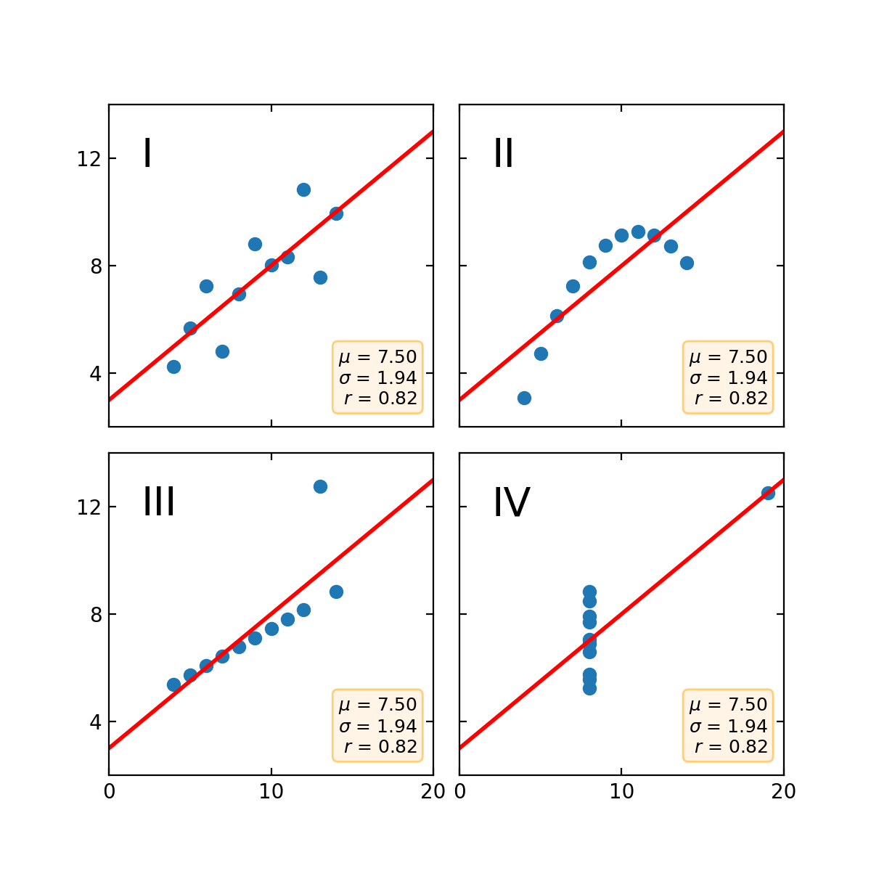
Anscombe’s Quartet
SUMMARY STATISTICS ARE NOT ENOUGH!!!
Regression Fits Data
Data is Non-Linear
Data contains outliers
Data contains outliers
(from another angle)

Slide 6
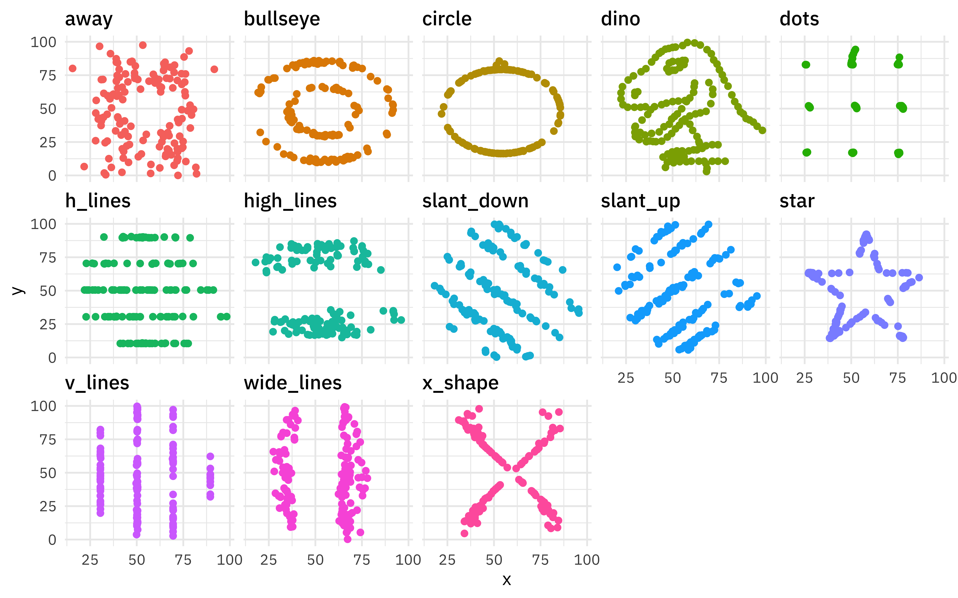
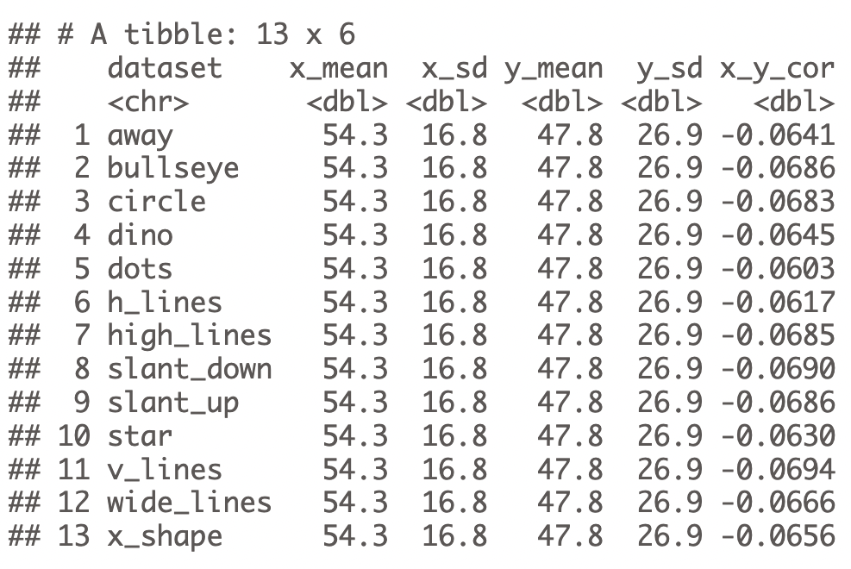
Datasaurus & Friends
SUMMARY STATISTICS ARE NOT ENOUGH!!!

Slide 7




Explore Interpret Report

Slide 8



Explore, Interpret, Report
Explore
Use visuals to understand data
Interpret
Use visuals to explain data
Report
Use visuals to summarize data

Slide 9
Explore

Slide 10
Picture your data
Look through your data and turn it into Visuals ASAP
Visualization should be a core part of Data Exploration

Slide 11
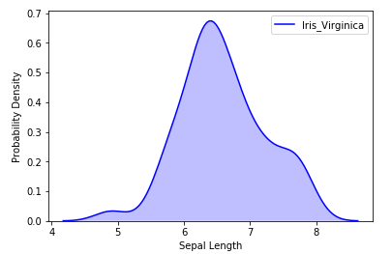
Distributions
Tell us how the data is spread out
Can show if data leans in a particular direction or if it’s normally distributed

Slide 12
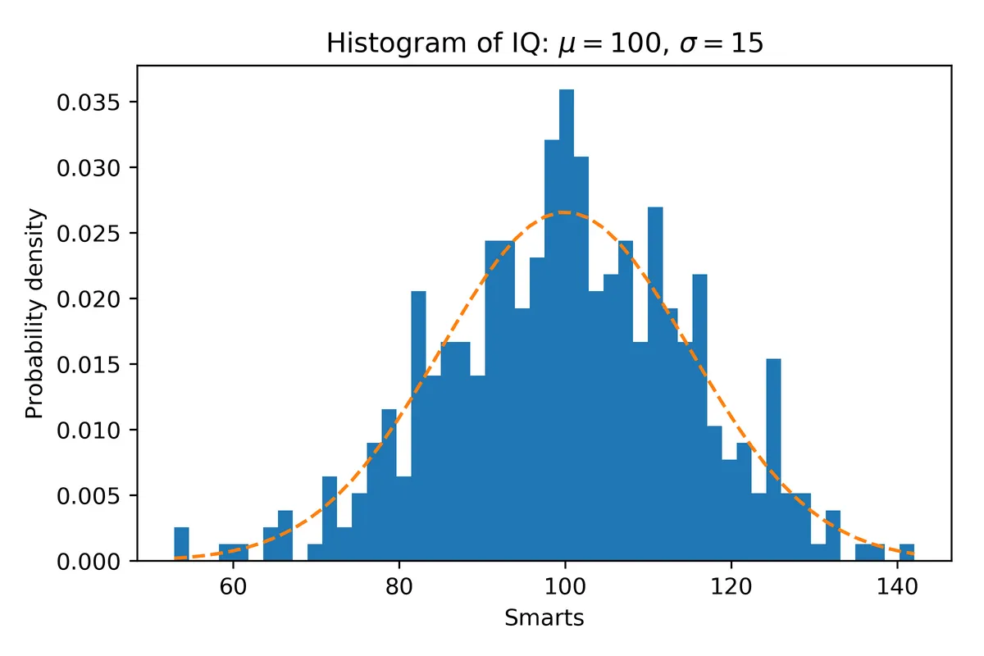
Frequencies
Shows distribution with discrete numbers
Essentially the same as Distributions
A distribution can be inferred through Histograms

Slide 13
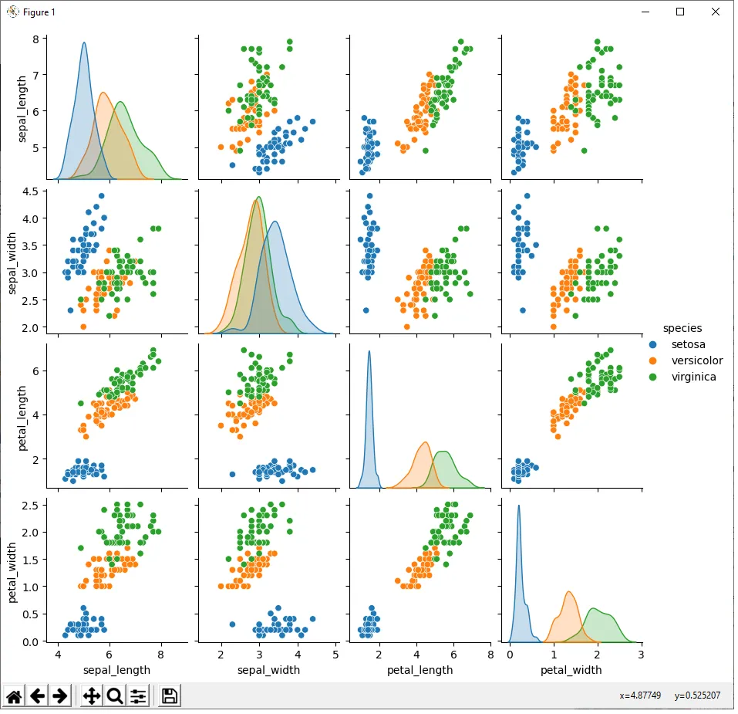
Relationships
pair-plots can show a clear relationships between features

Slide 14
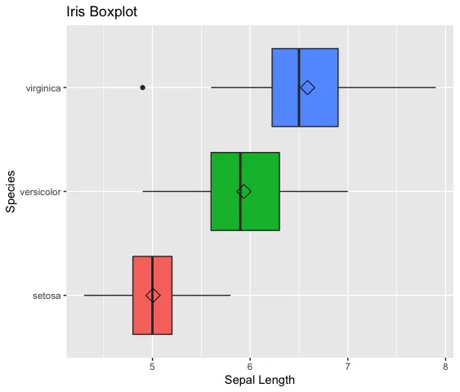
Outliers
Boxplots are an excellent way to identify outliers within a dataset
You can use violin-plots for more detail

Slide 15
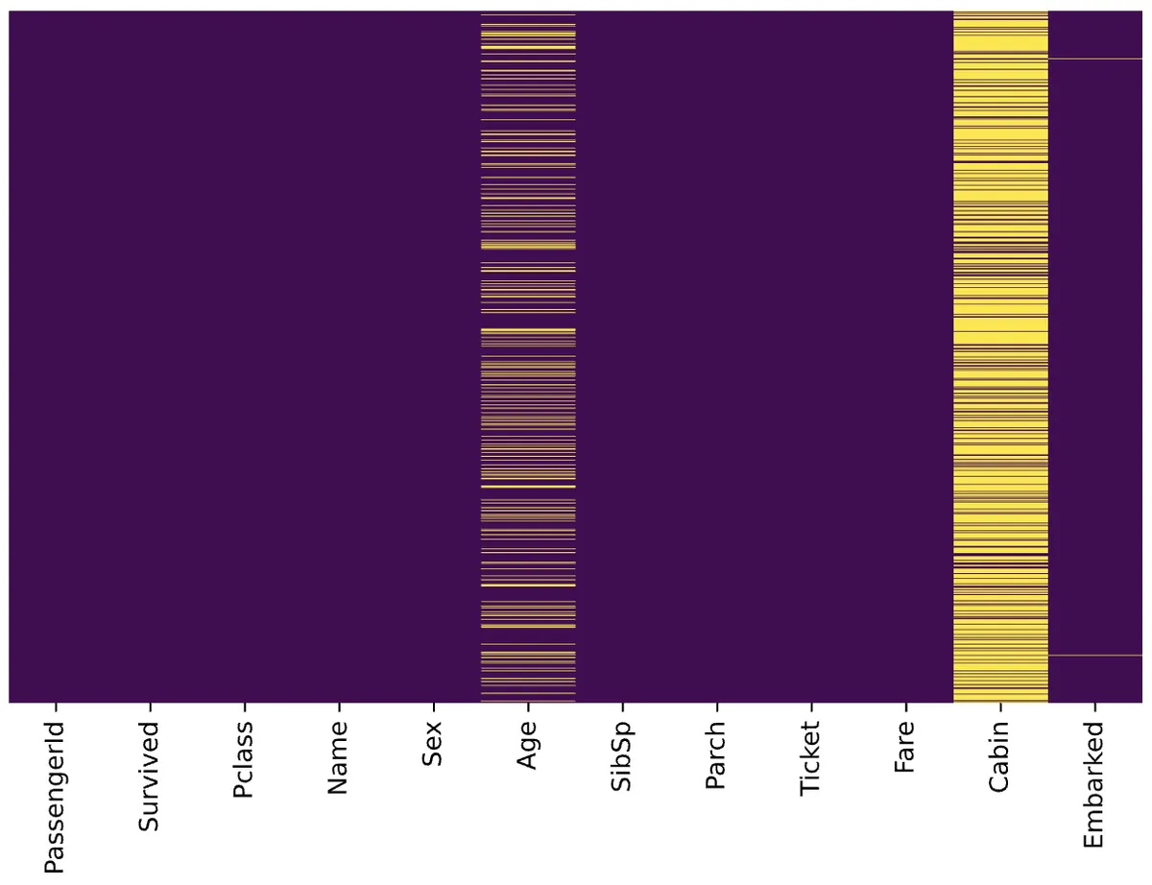
Missing Values
Heatmaps can be used to visualize missing values and their impact on a dataset

Slide 16
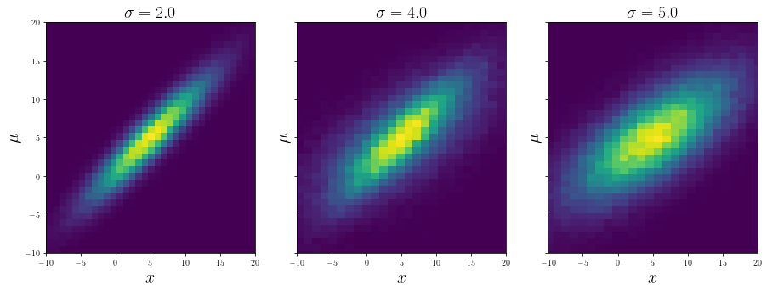
Conditionals
Setting a static parameter against features can sometimes inform us of certain trends in the data

Slide 17
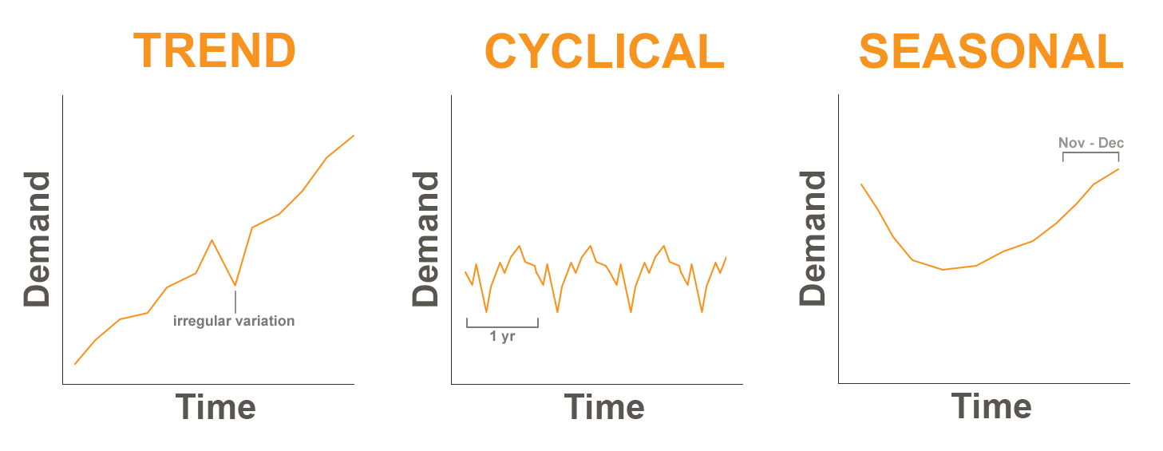
Time-Series – Trends, Cycles, Seasons

Slide 18
Interpret

Slide 19
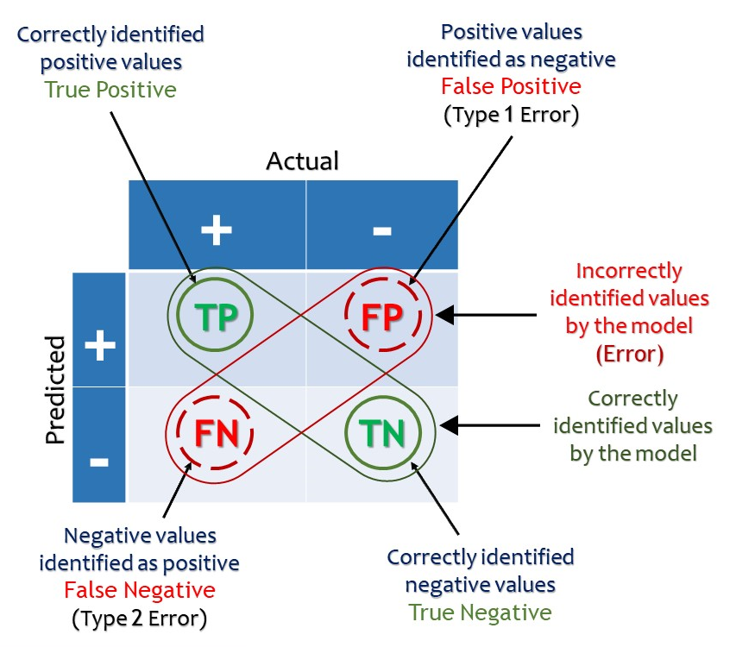
What were the Results?: Confusion Matrix

Slide 20
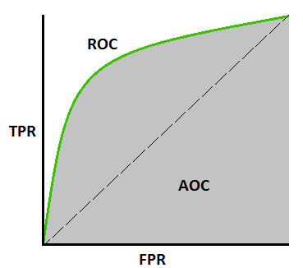
Which Model fits Best? : ROC / AUC
Receiver Operating Characteristic (ROC):
Compares True Positive & False Positive Rates to gauge how well a model fits to the data
Area Under the Curve (AUC):
The amount of space covered by the ROC Curve which indicates how well the model fits

Slide 21
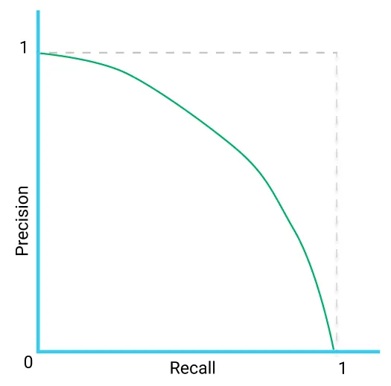
Which Model fits Best? : Precision-Recall Curve
Precision-Recall Curve:
Similar to ROC/AUC but uses Precision instead of FPR (also known as Fallout)
Precision is number of true positives out of all positive predictions (TP/P)
Recall is the number of true positives out of all true positives and false negatives (TP/TP + FN)

Slide 22
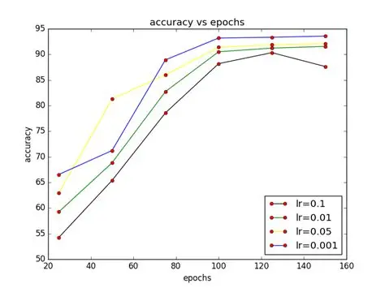
How did the Model Learn?
When appropriate, we should visualize our model learning process as well as key target metrics

Slide 23
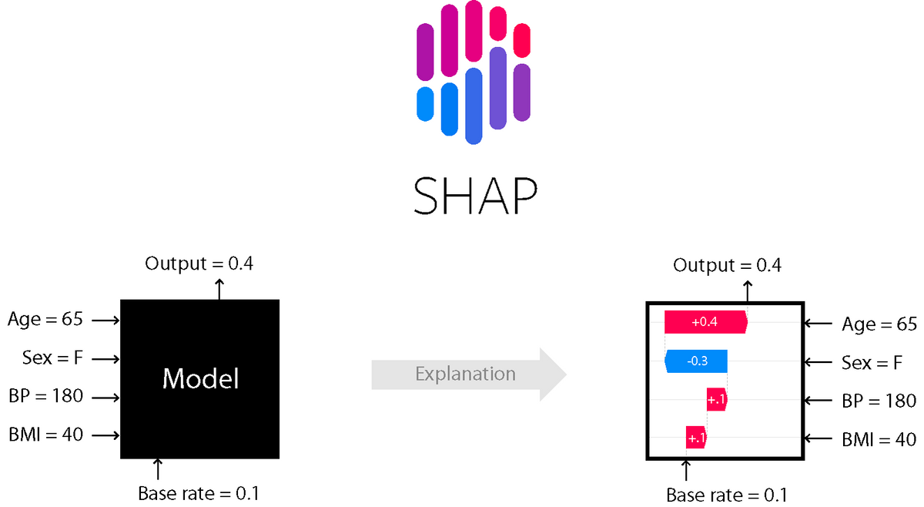
How Does the Model Work?
Shapley Additive Values are a model agnostic method for interpreting model outputs

Slide 24
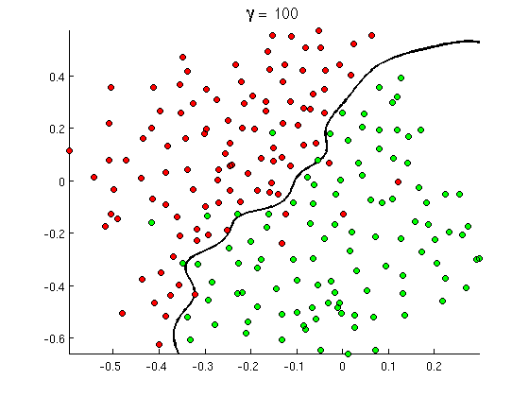
How Does the Model Work?
You can visualize the decision boundaries for a given model
If you have lots of features you can use Principal Component Analysis (PCA) to create a 2D representation of the data

Slide 25
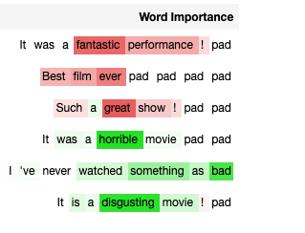
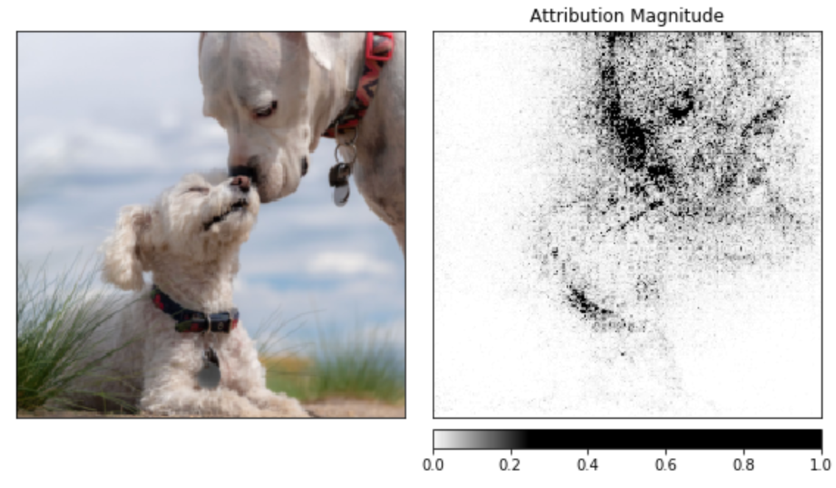
What is the model Looking at?:
Image uses captum.ai for PyTorch

Slide 26
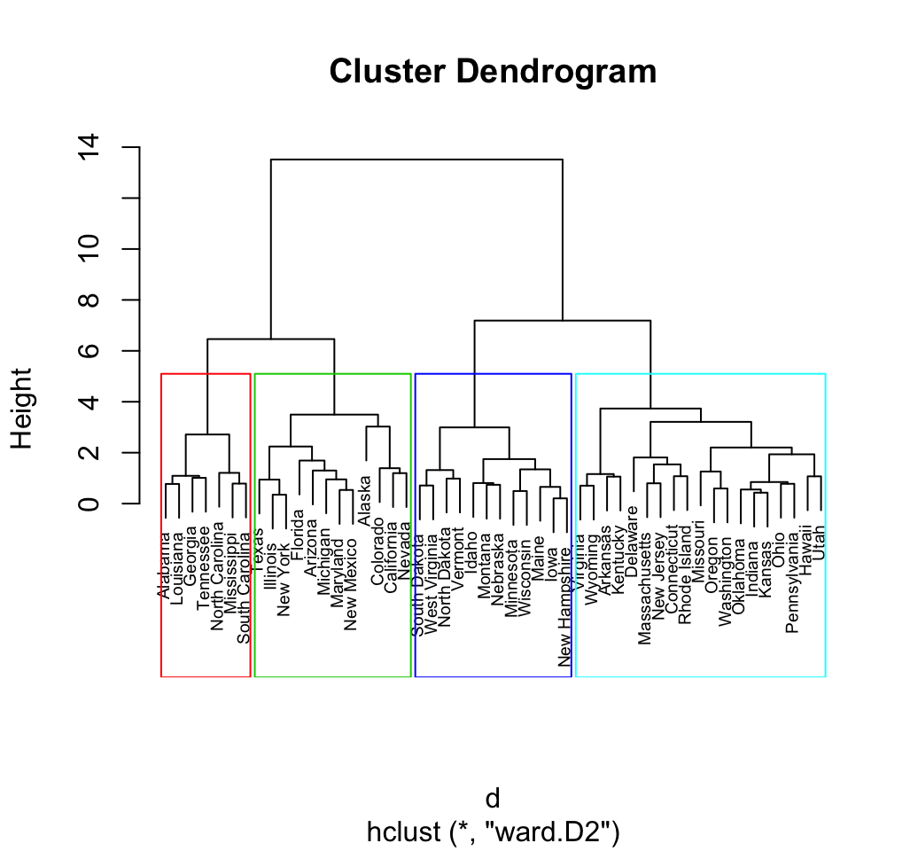
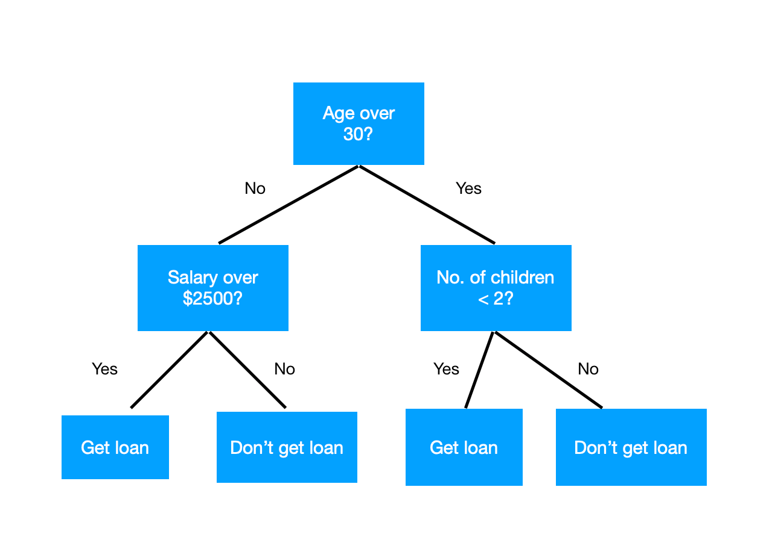
What does the model tell us? - Trees/Hierarchies

Slide 27
Report

Slide 28
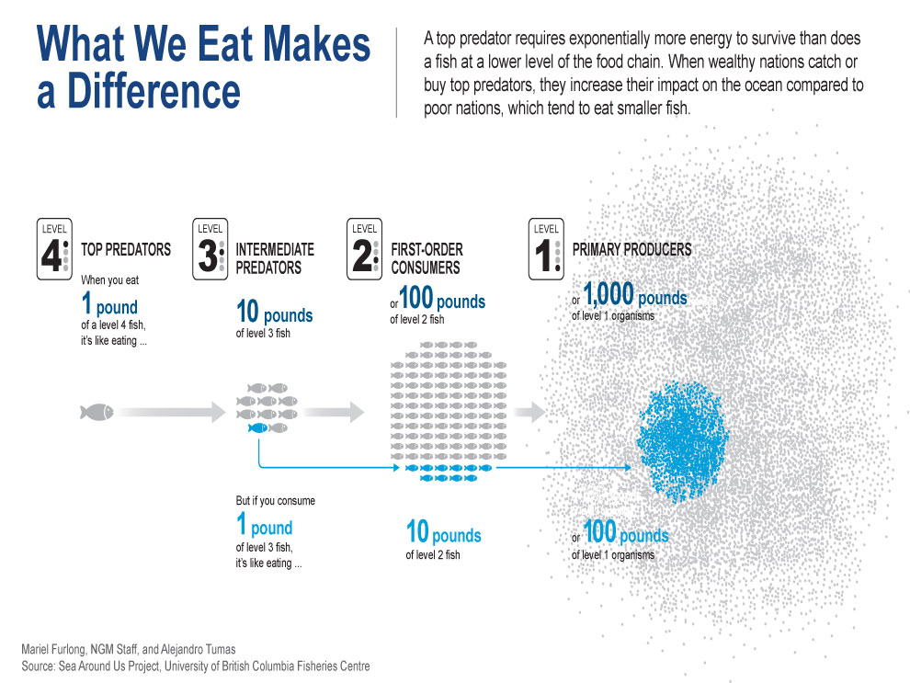
Big Picture | ”Storytelling”

Slide 29
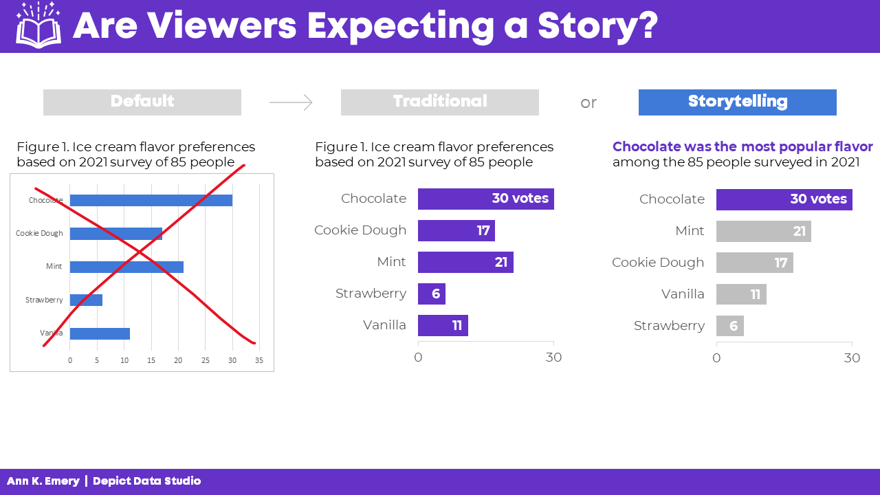
Recommended Charts/Ideas
Stick to bar-charts & line graphs
If a particular feature is important highlight it
Use a consistent theme across the board
Apply proper formatting and include labels where appropriate
Add context via footnotes

Slide 30
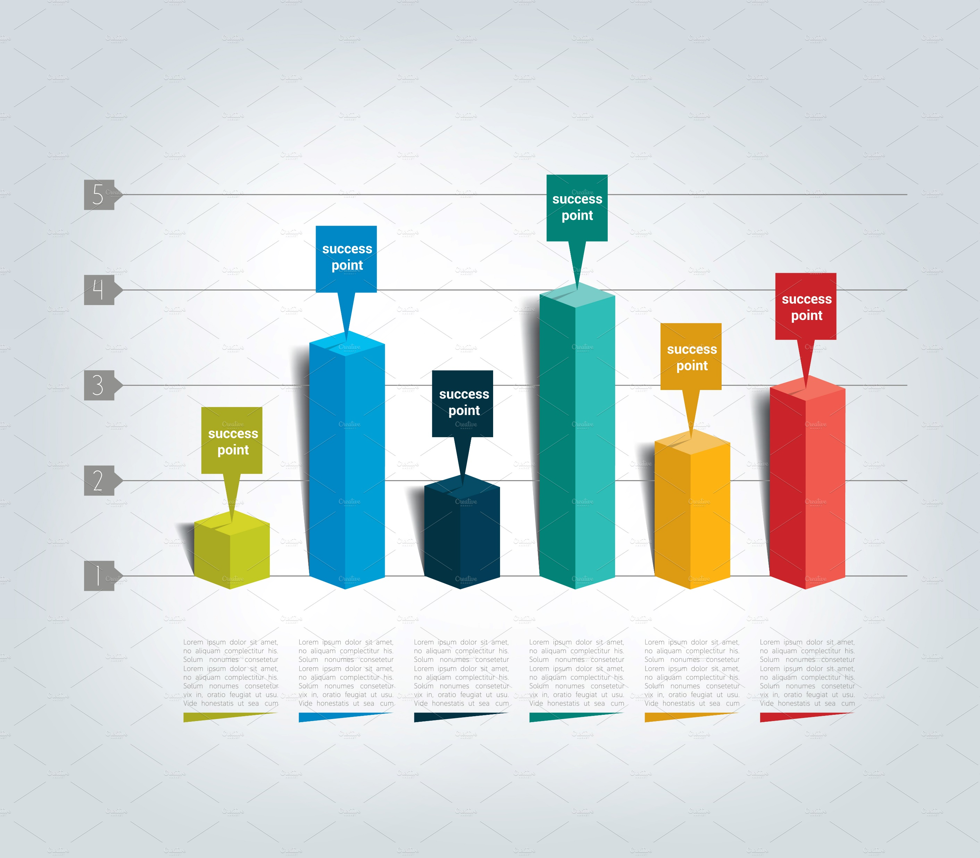
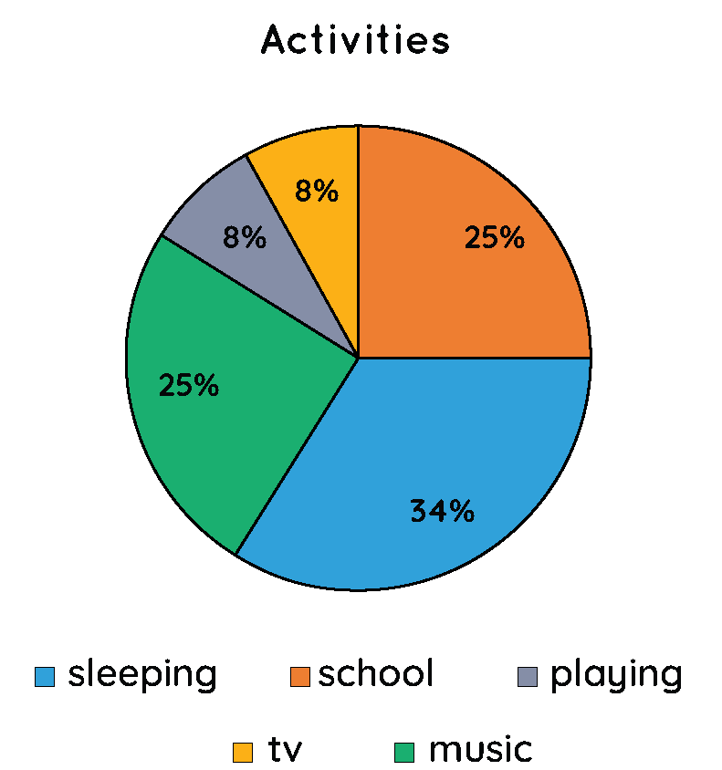
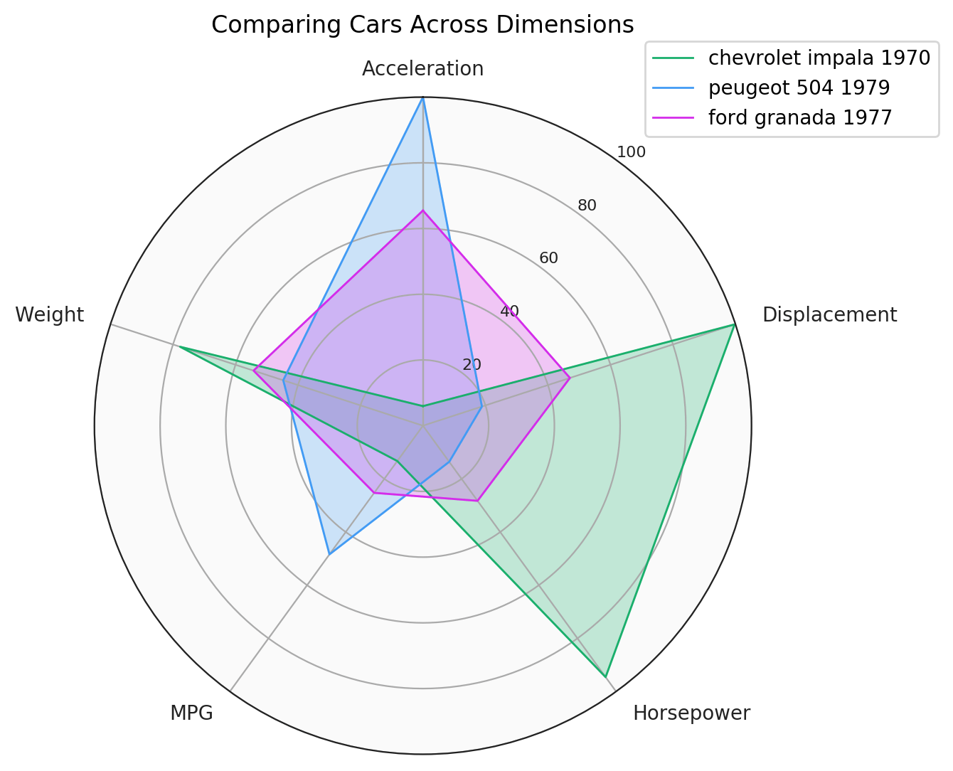
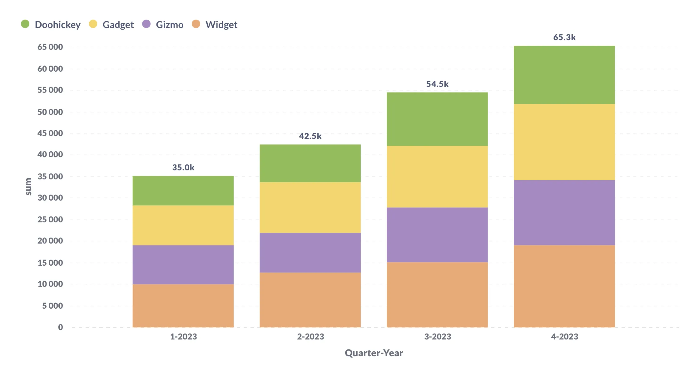
Avoid These…
There is a time and place for charts of all kinds, but some charts work better than others (generally…)
Charts that make it difficult to visually understand relationships (e.g. area charts of any kind) should be avoided unless perfectly suited to the message you’re conveying
Use color purposely and avoid oversaturating the page with noise

Slide 31
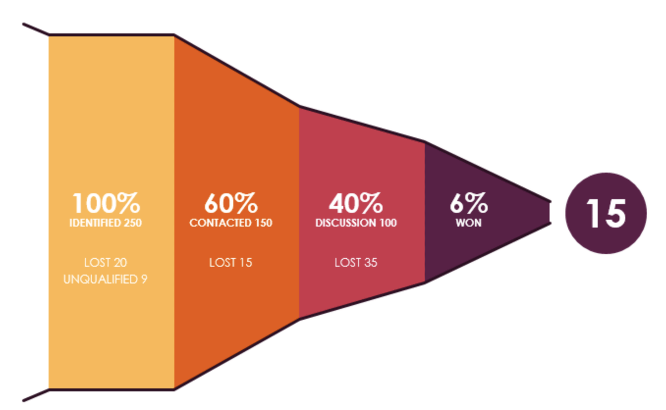
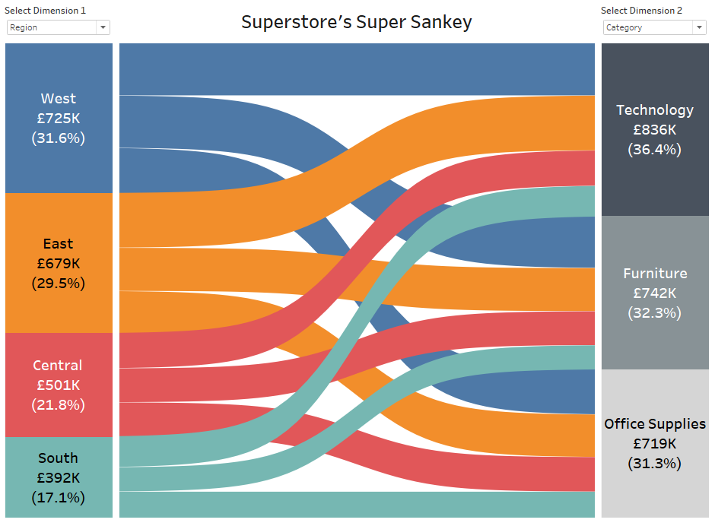
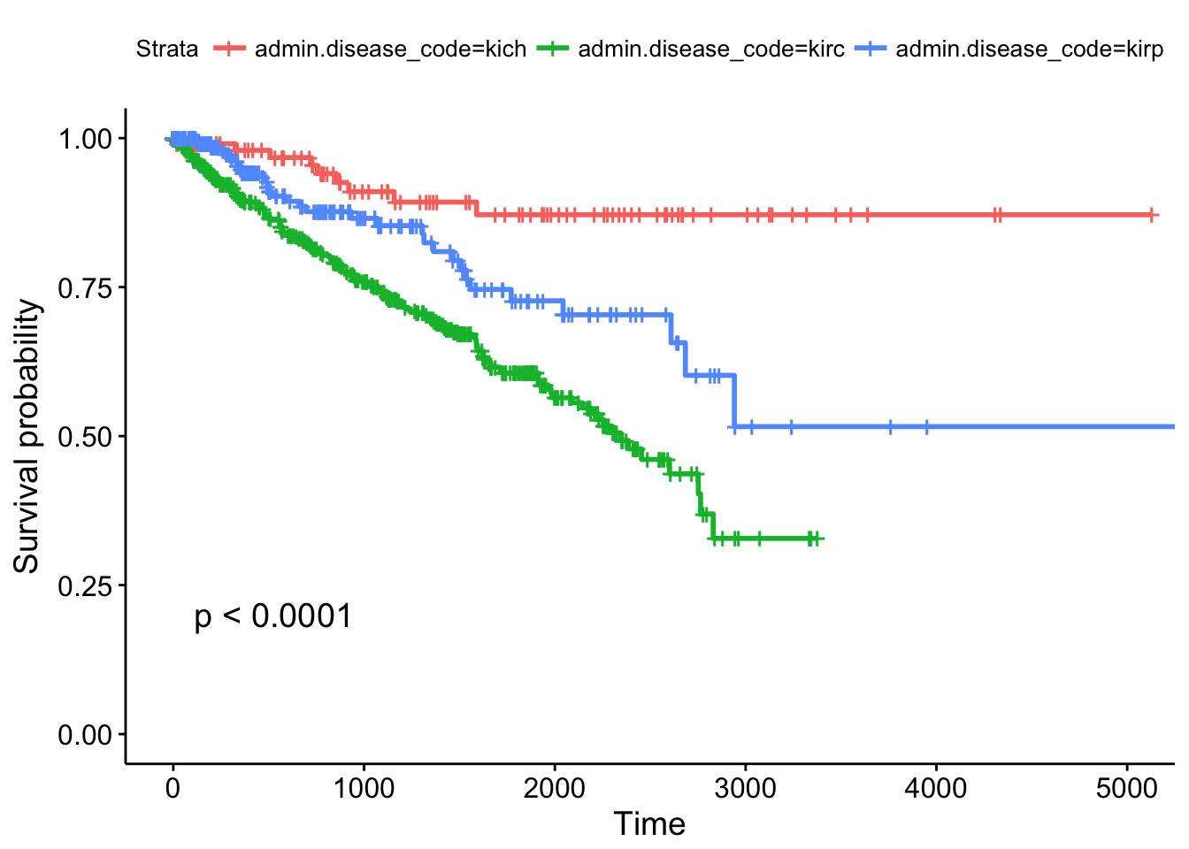
Extra Display Types!
⚠ USE WITH CAUTION ⚠
May be difficult to understand for your audience!

Slide 32
Things to Consider…
Key Performance Indicators (KPIs)
Basic Charts work Best (Lines & Bars)
Maintain consistent schemes throughout any report
Add any important discoveries as footnotes within report
Anticipate potential end user questions and investigations

Slide 33
End User
ALWAYS keep the End User in mind
Make sure you understand your data
Your work is a platform for others to make decisions on

Slide 34

Useful Tools & Resources

Slide 35


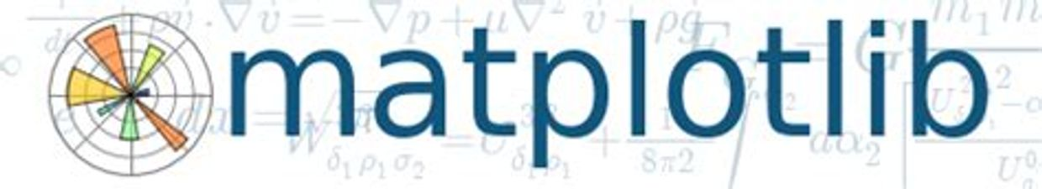



Python
lime.

Slide 36
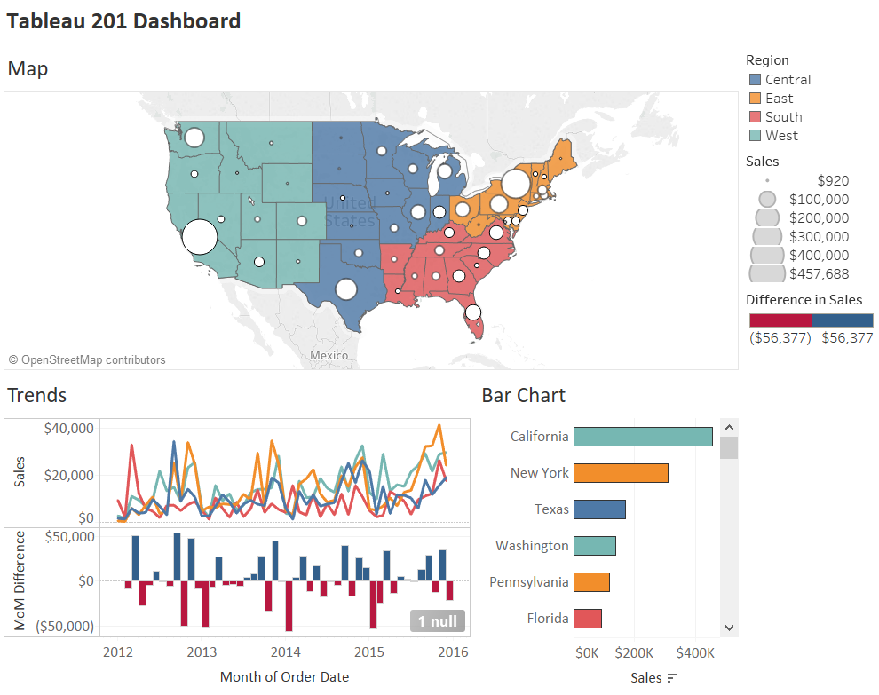
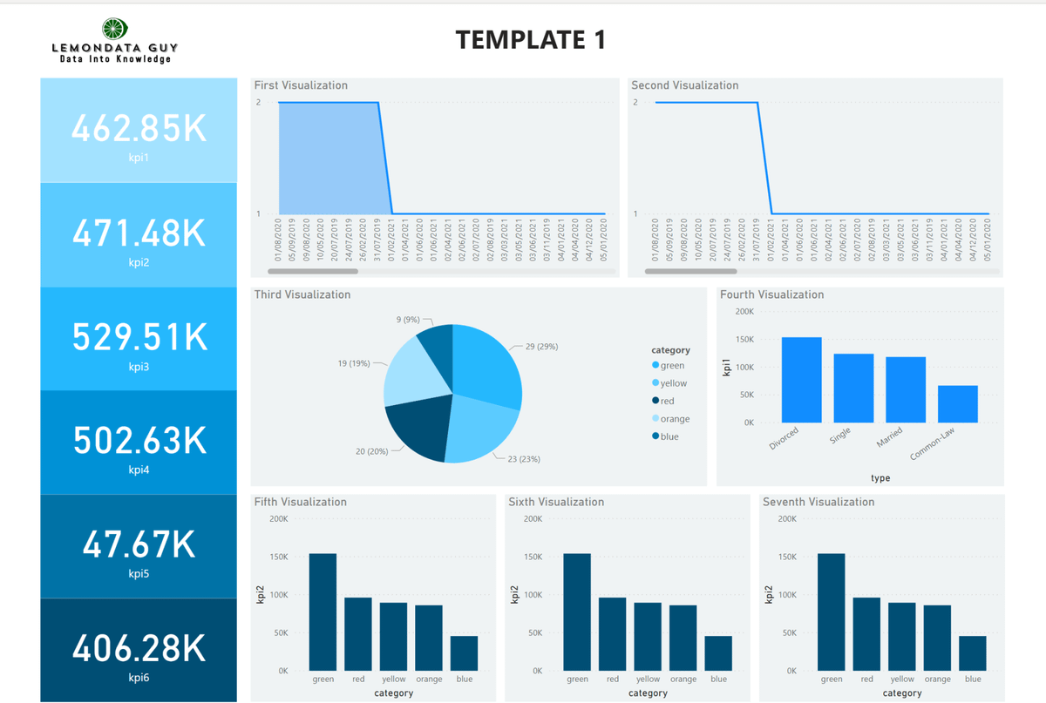


Business Intelligence

Slide 37





Web-App Frameworks

Slide 38
Final Thoughts
Work on your workflow
Explore new ways to explore
Communicate with your End User

Slide 39

Questions?
GitHub Repo
Adrian Gallard | Digital Learning Data Analyst
agallard3@gatech.com
https://github.com/ajgallard/vip

